Slide 1
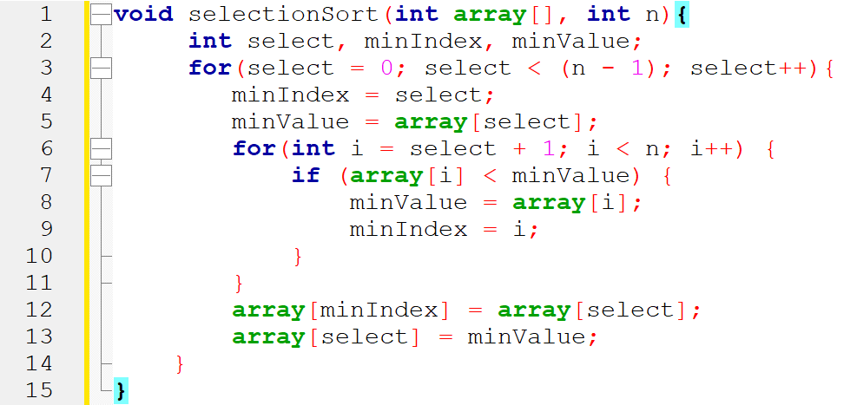
index | 0 | 1 | 2 | 3 | 4 | 5 | 6 | array
value | 12 | 16 | 84 | 42 | 14 | 26 | 53
Line 2: select , minIndex, minValue
Line 3: for ( select= 0, select < 6; select ++) , select =0
Line 4: minIndex= select , minIndex = 0
Line 5: minValue= array[0]= 12
Line 6: for ( i=1 ; i <7 ; i++) , i=1
Line 7: if ( array[i]< minValue) if( array[1] < 12) if( 16 <12 ) --false
Line 6: for ( i=1 ; i <7 ; i++) , i=2
Line 7: if ( array[i]< minValue) if( array[2] < 12) if( 84 <12 ) --false

Slide 2
index | 0 | 1 | 2 | 3 | 4 | 5 | 6 | array
value | 12 | 16 | 84 | 42 | 14 | 26 | 53
Line 3: for : select =1
Line 4: minIndex = select, minIndex= 1
Line 5: minValue= array[select]= array[1] = 16
Line 6 : for ( i=2, i <7 ; i++) , i=2
Line 7 : if( array[2] < minValue) if( 84 < 16) --- false
Line 6:for ( i=2, i <7 ; i++) , i=3
Line 7 : if( array[3] < minValue) if( 42 < 16) --- false

Slide 3
index | 0 | 1 | 2 | 3 | 4 | 5 | 6 | array
value | 12 | 16 | 84 | 42 | 14 | 26 | 53
Line 6:for ( i=2, i <7 ; i++) , i=4
Line 7 : if( array[4] < minValue) if( 14< 16) --- true
Line 8 : minValue = 14
Line 9 : minIndex = 4
Line 6:for ( i=2, i <7 ; i++) , i=5
Line 7: if( array[5] < minValue) if( 26 < 14) --- false
Line 6:for ( i=2, i <7 ; i++) , i=6
Line 7: if( array[6] < minValue) if( 53 < 14) --- false

Slide 4
index | 0 | 1 | 2 | 3 | 4 | 5 | 6 | array
value | 12 | 14 | 84 | 42 | 16 | 26 | 53
Line 8 : minValue = 14
Line 9 : minIndex = 4
Line 12: array[minIndex] = array[select] array[4] = array[1] array[4]= 16
Line 13: array[select]=minValue array[1] = 14

